Slide 1
DATA ANALYSIS ON CRYPTOCURRENCY MARKET
BY
R.Namratha
- 22N31A12F2

Slide 2
CONTENTS
ABSTRACT
INTRODUCTION
PROPOSED SYSTEM
SYSTEM REQUIREMENTS
RESULT
CONCLUSION

Slide 3
ABSTRACT
Cryptocurrency, or crypto, is a digital payment platform that eliminates the need to carry physical money. It exists only in digital form, and although people mainly use it for online transactions, you can make some physical purchases. Unlike traditional money printed only by the government, several companies sell cryptocurrency. Cryptocurrencies are fast becoming rivals to traditional currency across the world.The digital currencies are available to purchase in many different places, making them accessible to everyone, and with retailers accepting various cryptocurrencies, it could be a sign that money as we know it is about to go through a major change. Cryptocurrency is stored in digital wallets. Cryptocurrency received its name because it uses encryption to verify transactions. This means advanced coding is involved in storing and transmitting cryptocurrency data between wallets and public ledgers. Encryption aims to provide security and safety. The first cryptocurrency was Bitcoin, which was founded in 2009 and remains the best known today. Much of the interest in cryptocurrencies is to trade for profit, with speculators at times driving prices skyward. Cryptocurrencies continue to draw a lot of attention from investors, entrepreneurs, regulators, and the general public. Many recent public discussions of cryptocurrencies have been triggered by the substantial changes in their prices, claims that the market for cryptocurrencies is a bubble without any fundamental value, and also concerns about evasion of regulatory and legal oversight. These concerns have led to calls for increased regulation or even a total ban.

Slide 4
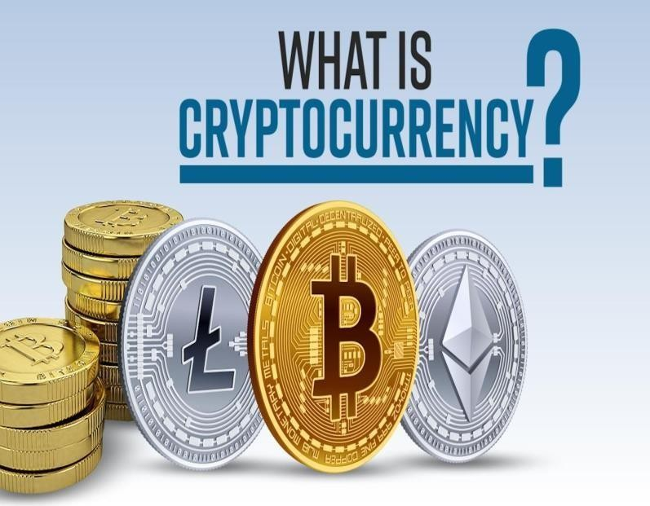
INTRODUCTION
Cryptocurrency is a digital asset designed to work as a medium of exchange that uses strong cryptography to secure financial transactions.
Cryptocurrency, or crypto, is a digital payment platform that eliminates the need to carry physical money.
It exists only in digital form, and although people mainly use it for online transactions, you can make some physical purchases. Unlike traditional money printed only by the government, several companies sell cryptocurrency.
Cryptocurrencies are fast becoming rivals to traditional currency across the world. The digital currencies are available to purchase in many different places, making it accessible to everyone.

Slide 5
PROPOSED SYSTEM
Here are some trends and potential developments that can be considered as part of a proposed systems.
Addressing scalability issues, such as high transaction fees and slow processing times, is a key focus area. Proposed solutions include implementing layer-two protocols like the Lightning Network for Bitcoin or exploring alternative consensus mechanisms to increase transaction throughput.
Improving privacy features to protect users financial data and transactional privacy. Zero- knowledge proofs, ring signatures, and other cryptographic techniques are being integrated into various cryptocurrencies to enhance privacy while maintaining transparency and auditability.
Developing frameworks and tools to ensure regulatory compliance within the cryptocurrency ecosystem, such as Know Your Customer (KYC) and Anti-Money Laundering (AML) measures. Projects focusing on regulatory compliance aim to bridge the gap between traditional finance and decentralized systems.

Slide 6
SYSTEM REQUIREMENTS
HARDWARE REQUIREMENTS
Memory (RAM) : 4-8GB
Disk Space : 350 GB
ARM chipsets > 1GHz
AMD or NVIDIA graphic cards
SOFTWARE REQUIREMENTS
Programming Language – Python
Module – Pandas
Operating Systems - Windows

Slide 7
EXCEL SHEET

Slide 8
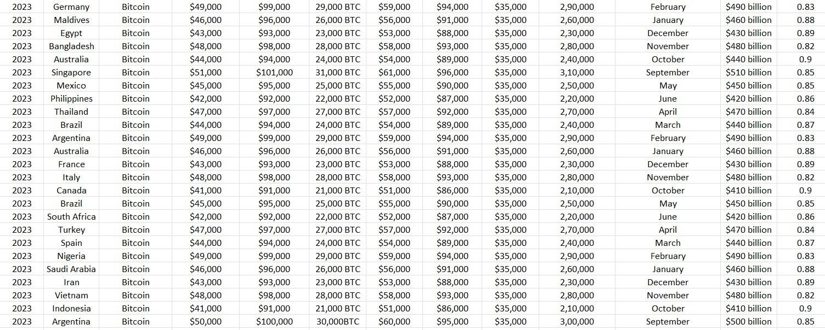

Slide 9
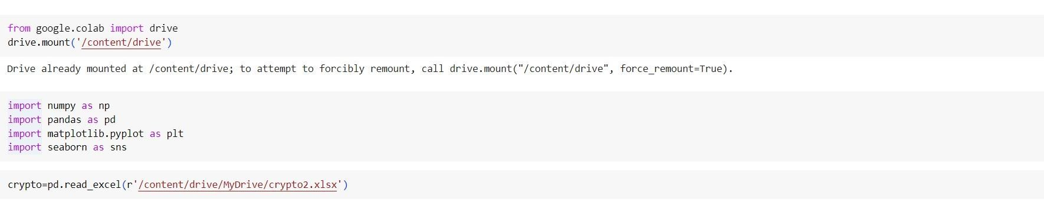

Slide 10
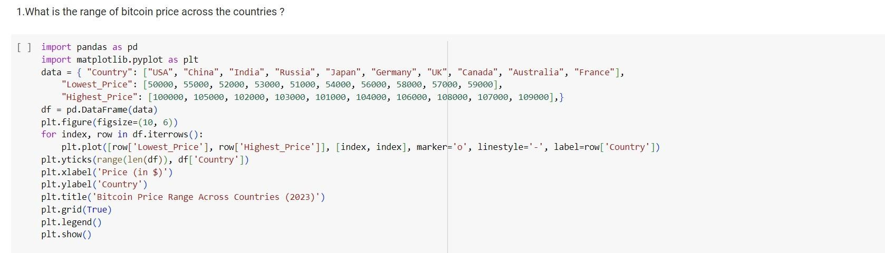

Slide 11
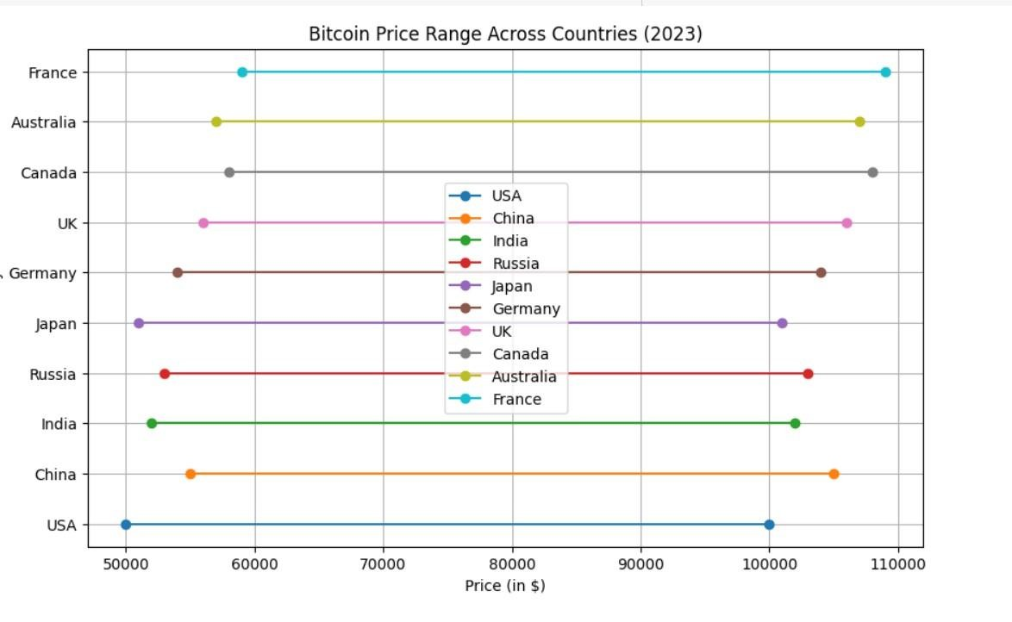

Slide 12
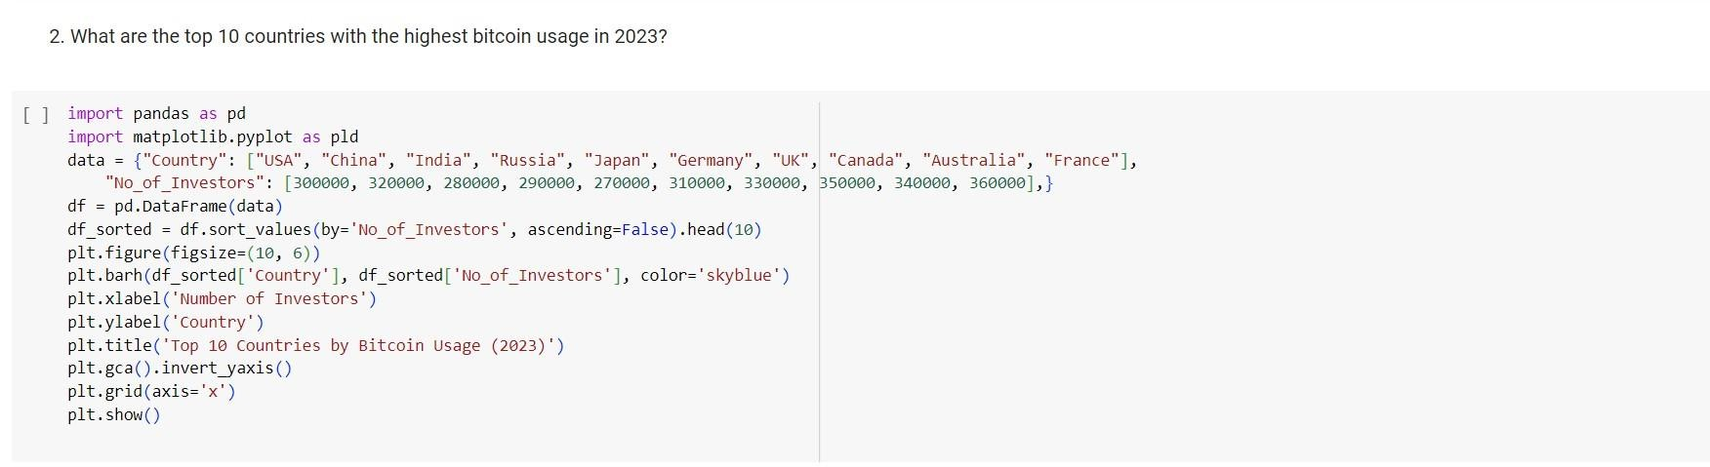

Slide 13
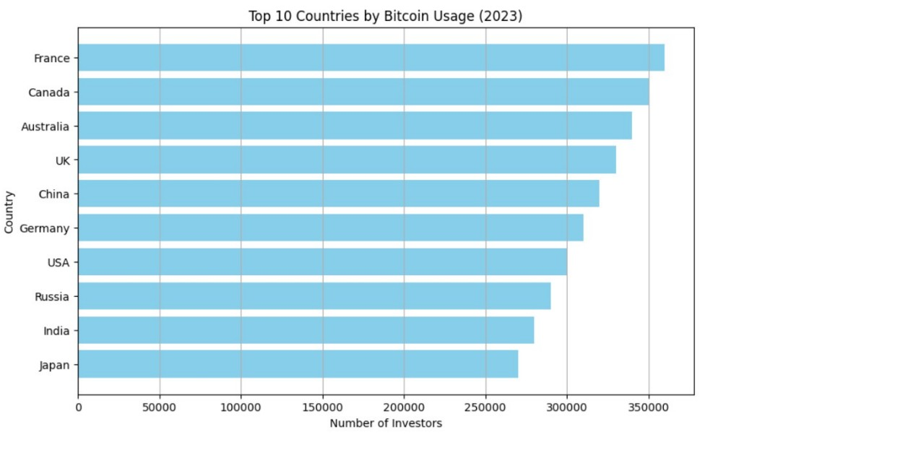

Slide 14
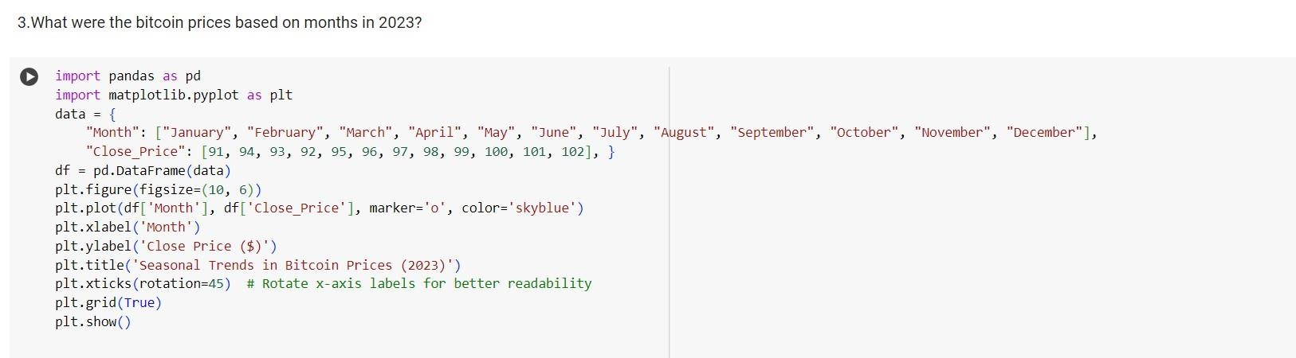

Slide 15
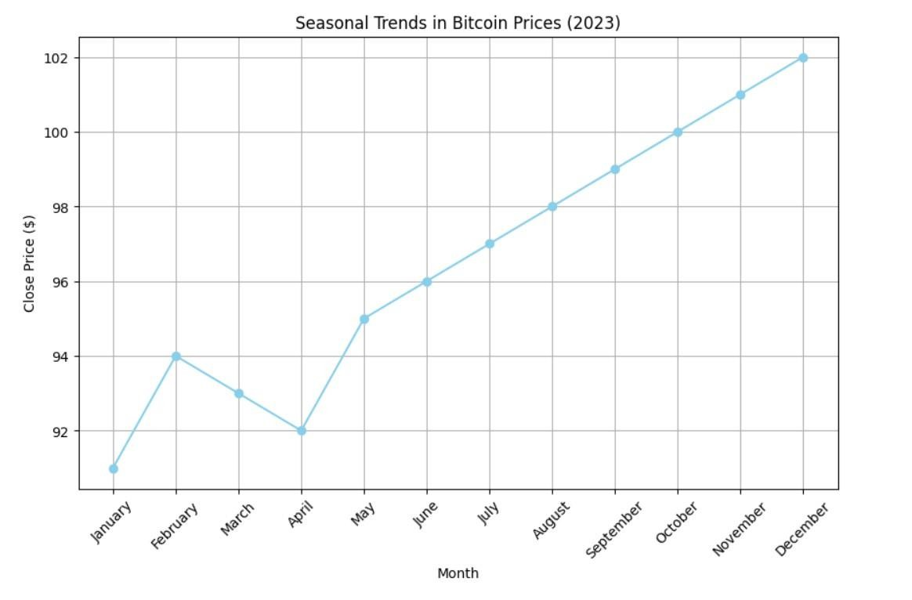

Slide 16
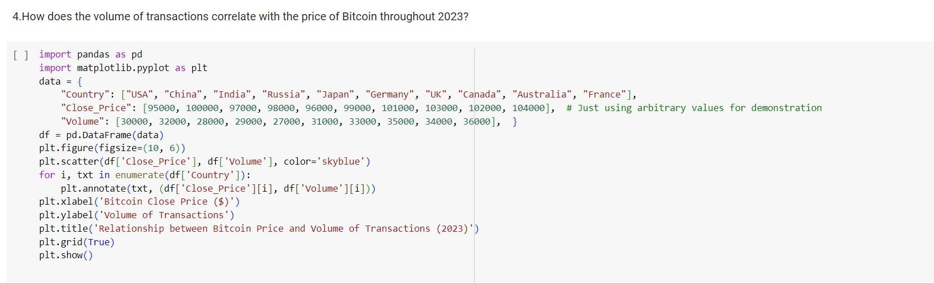

Slide 17
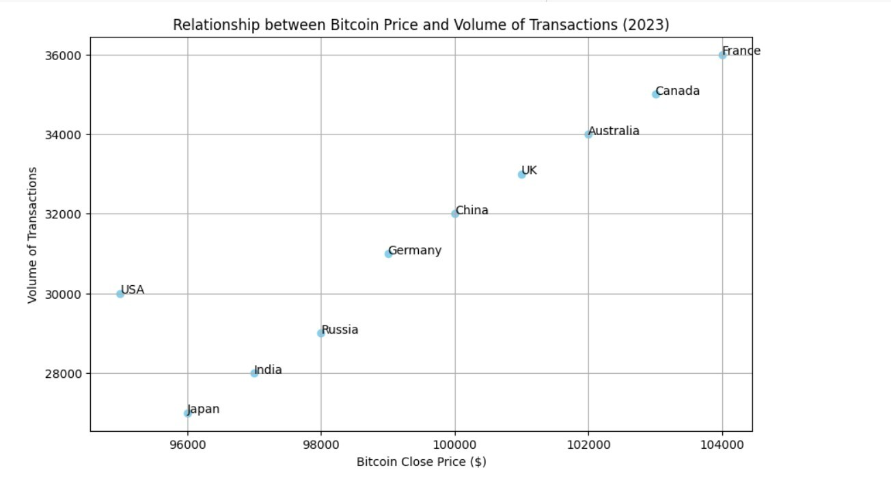

Slide 18
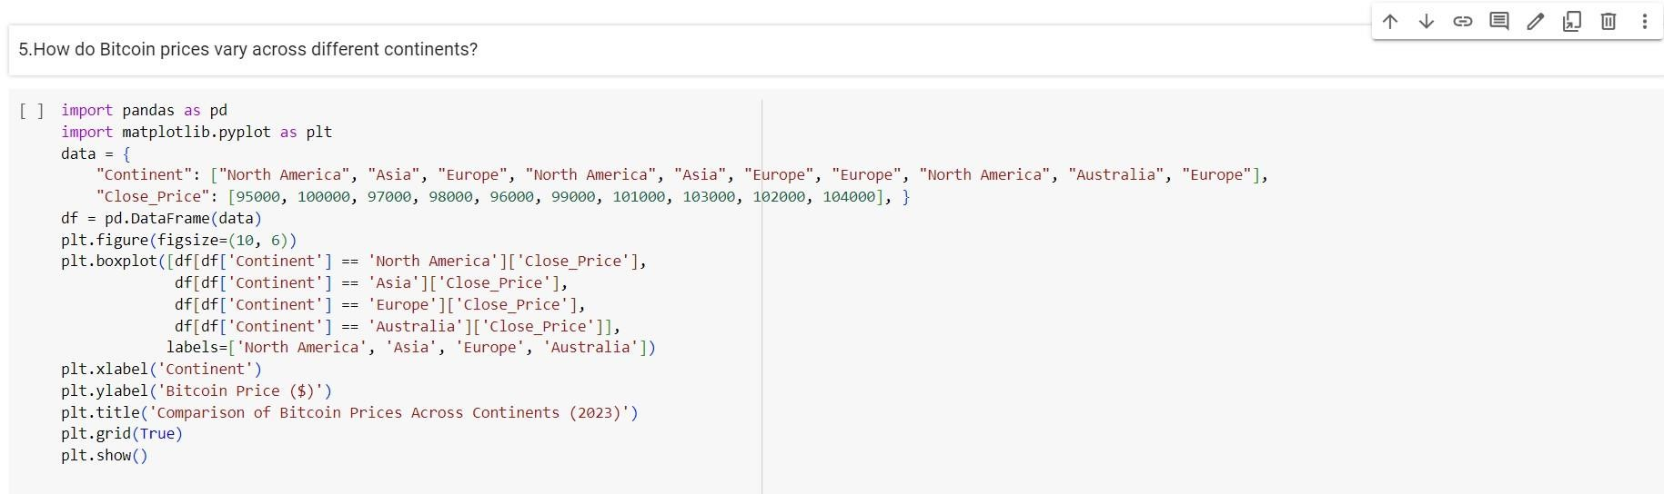

Slide 19
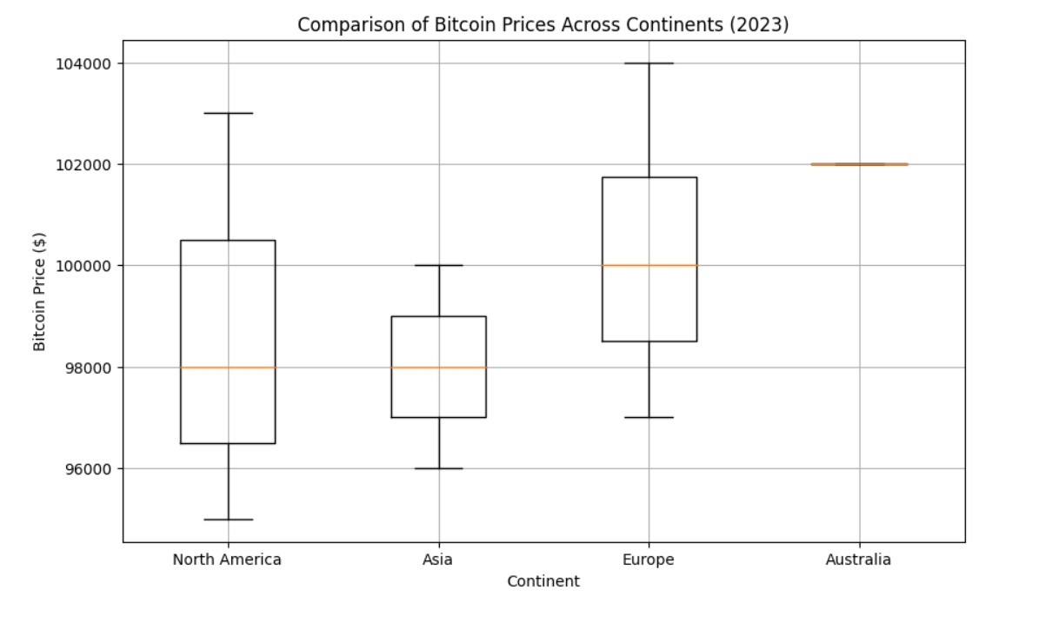

Slide 20
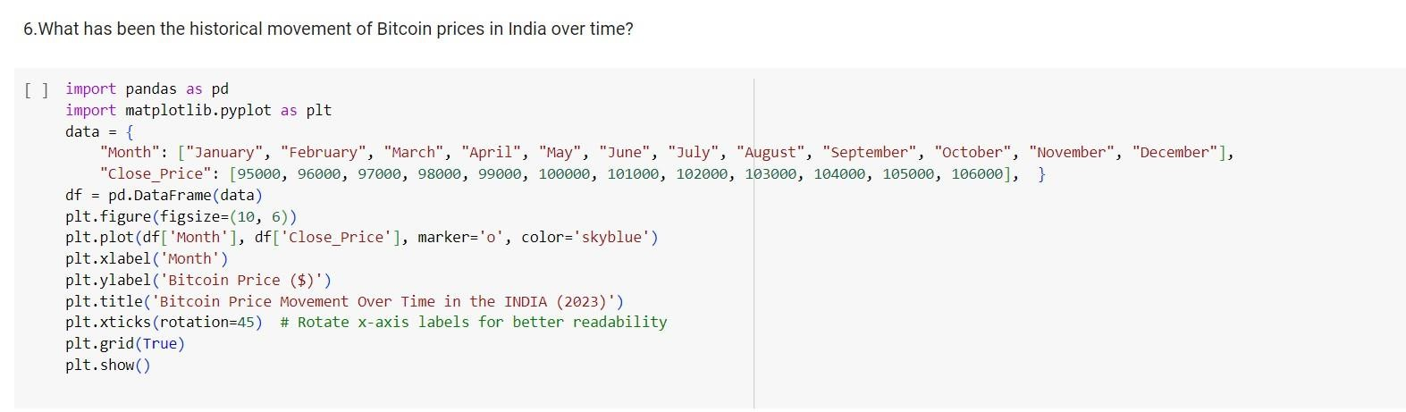

Slide 21
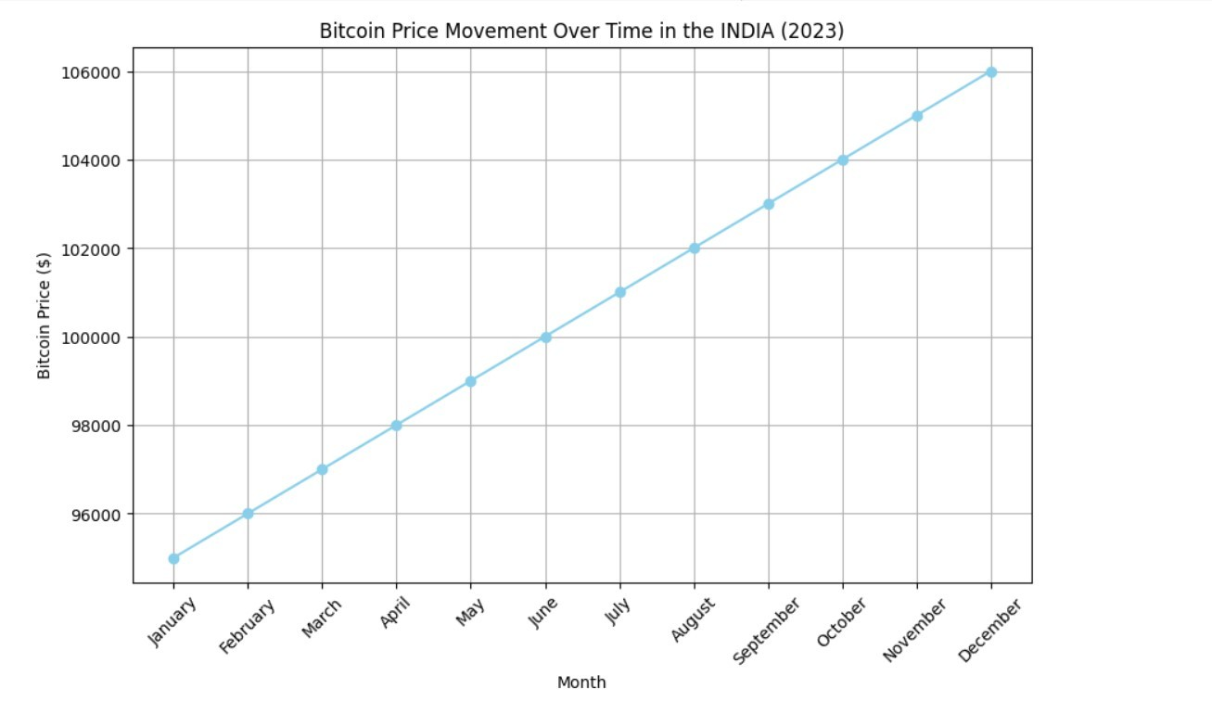

Slide 22
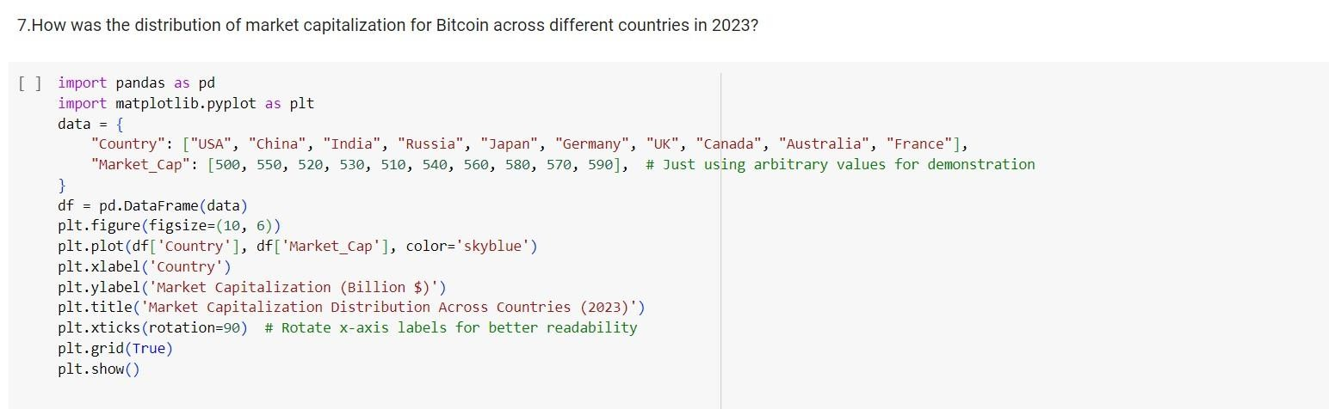

Slide 23
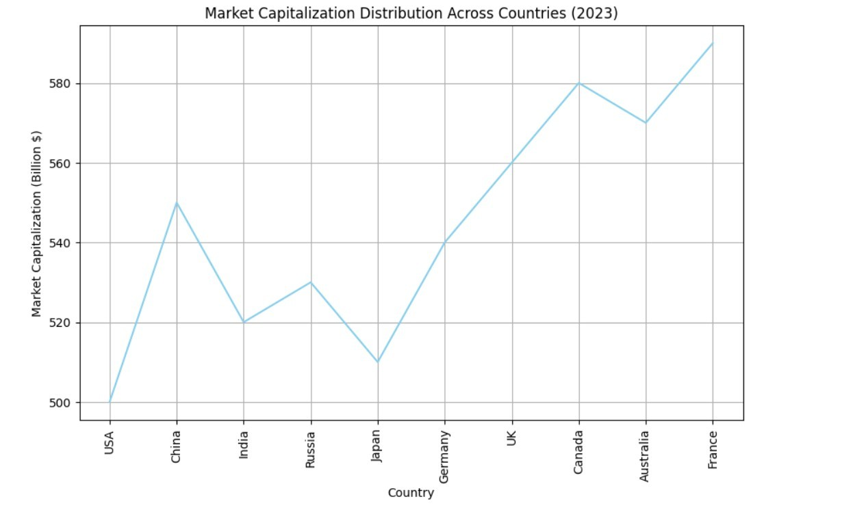

Slide 24
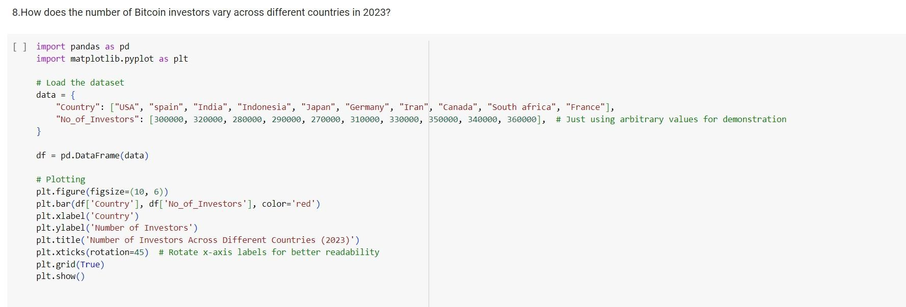

Slide 25
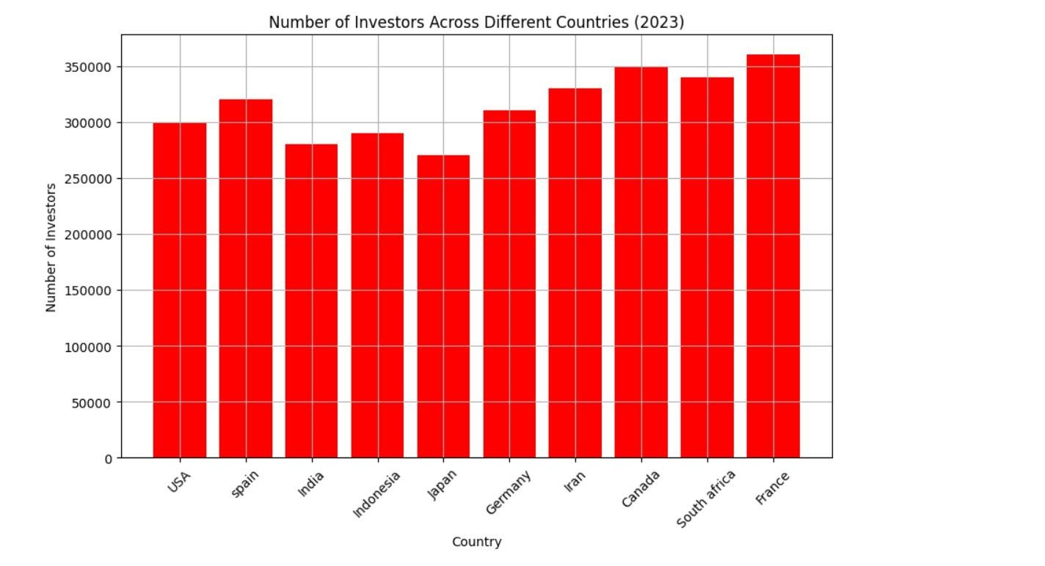

Slide 26


Slide 27
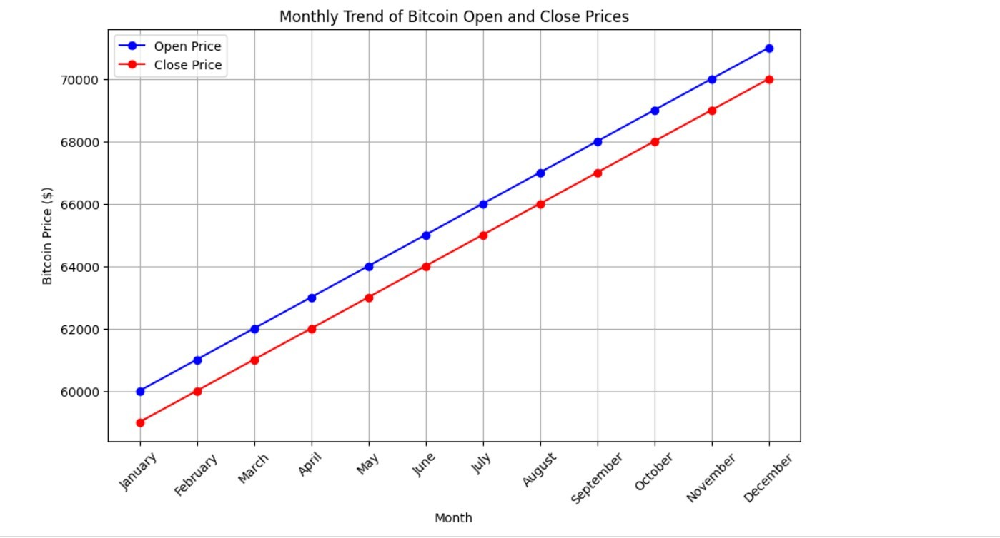

Slide 28
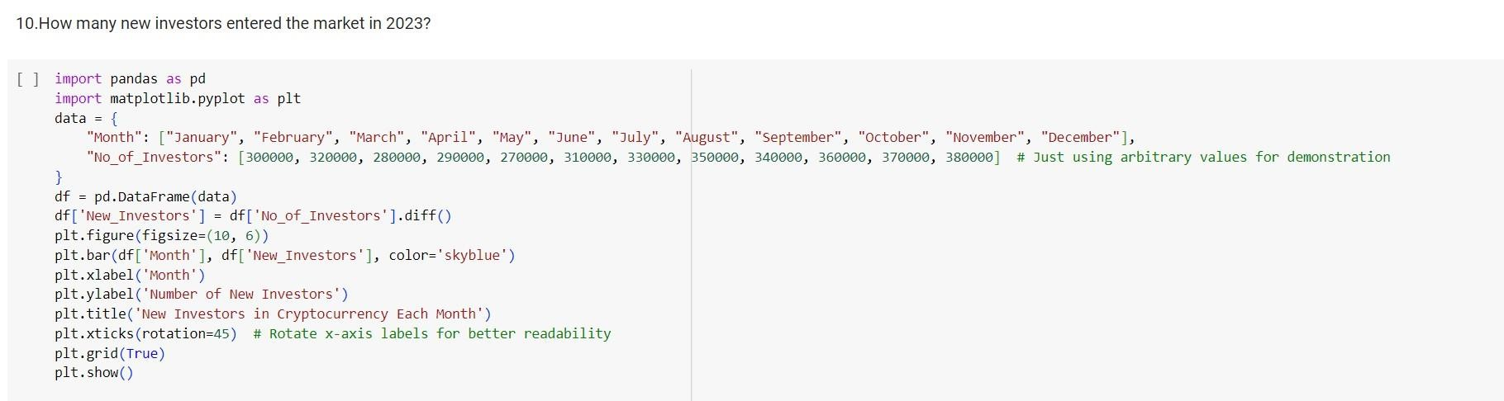

Slide 29
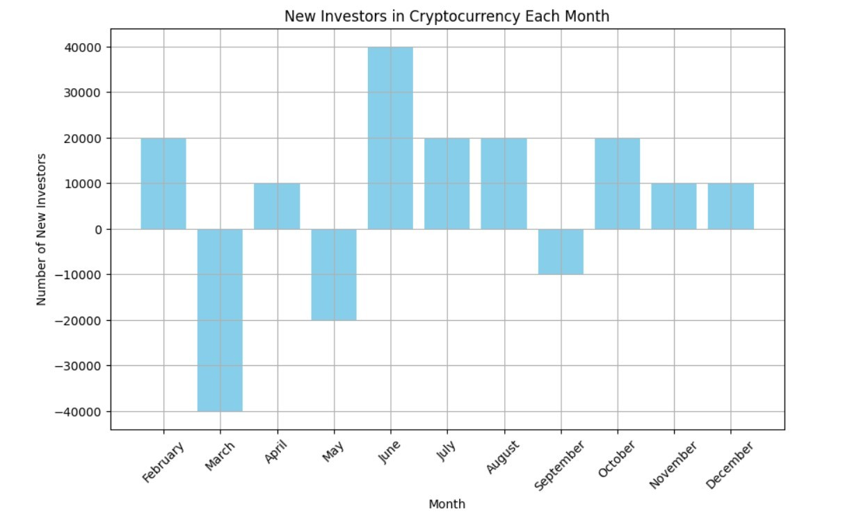

Slide 30
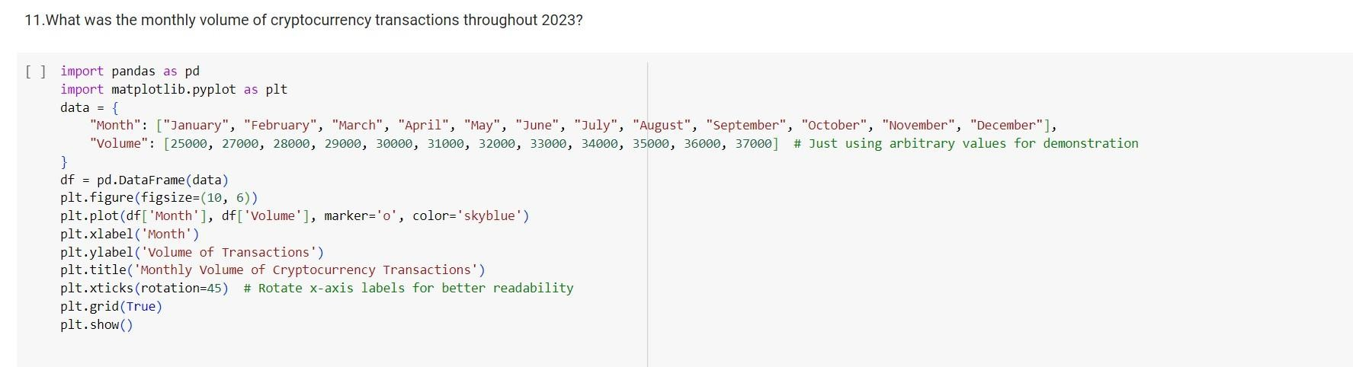

Slide 31
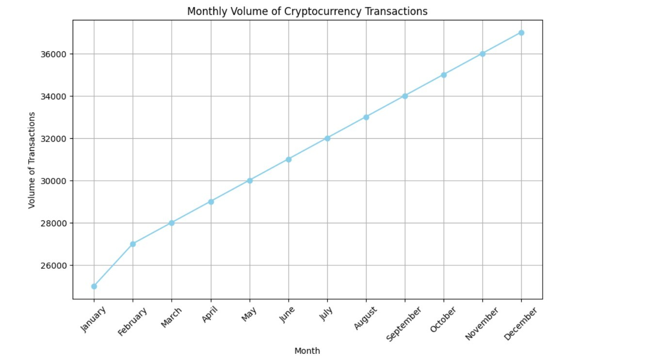

Slide 32
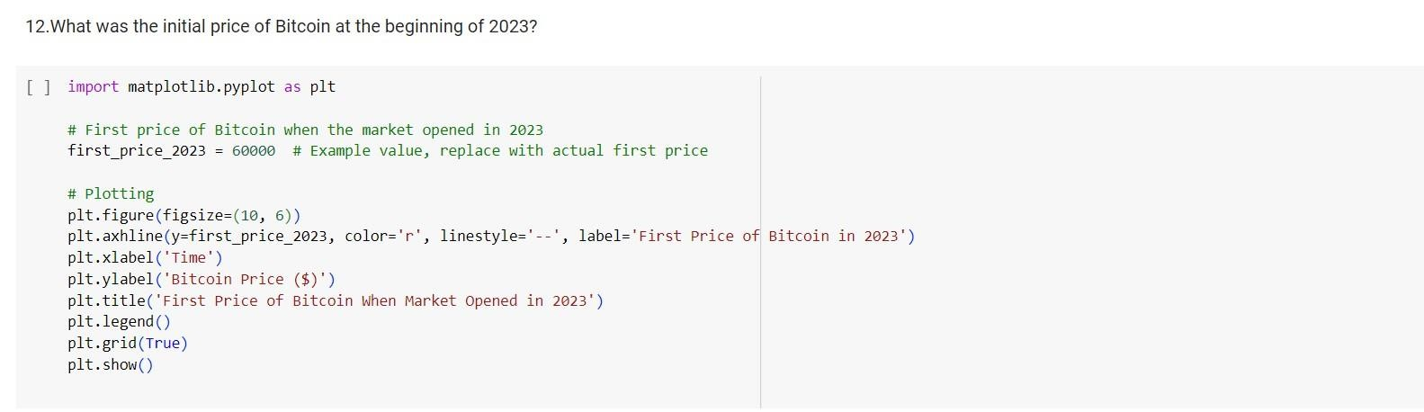

Slide 33
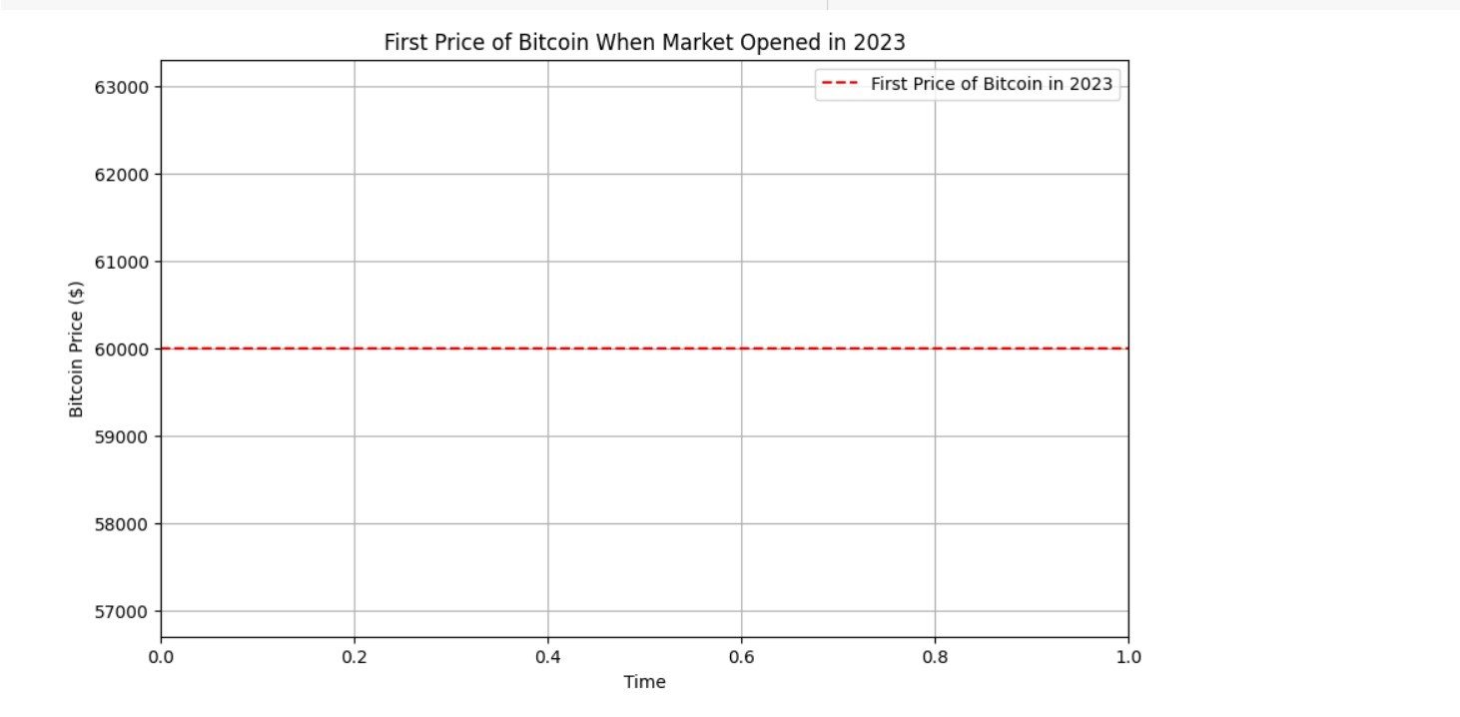

Slide 34
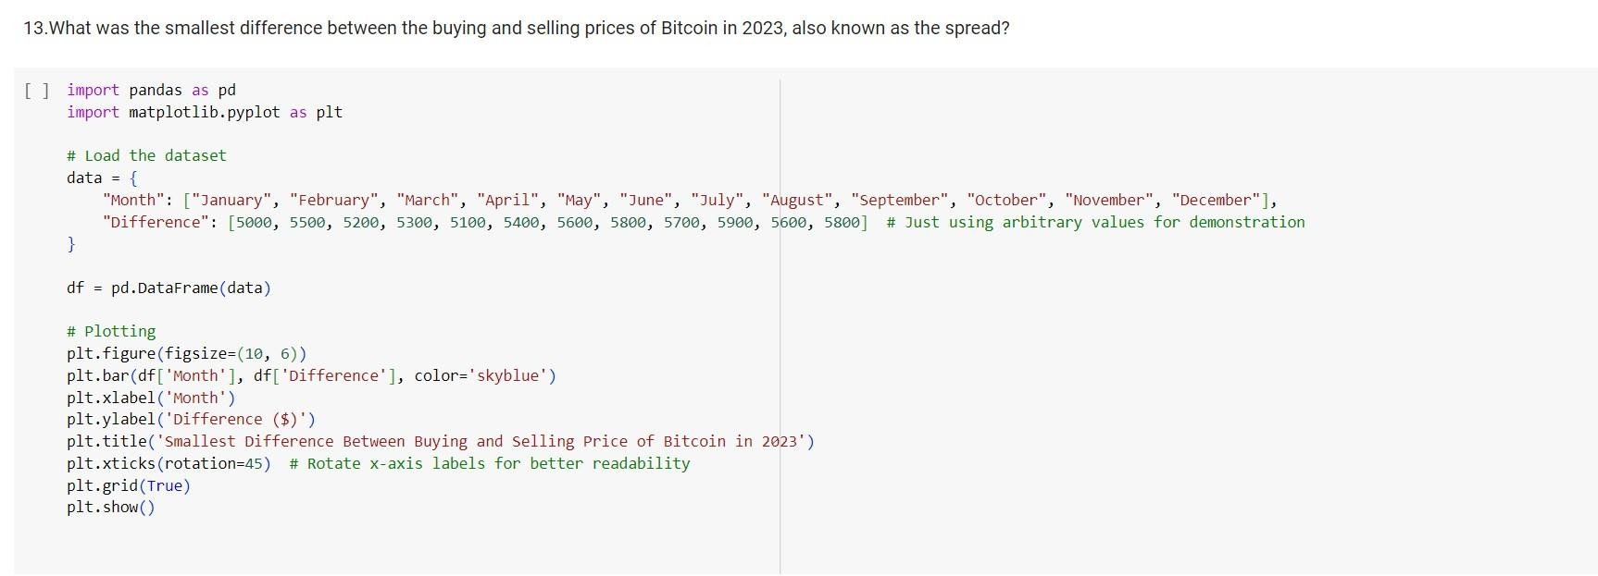

Slide 35
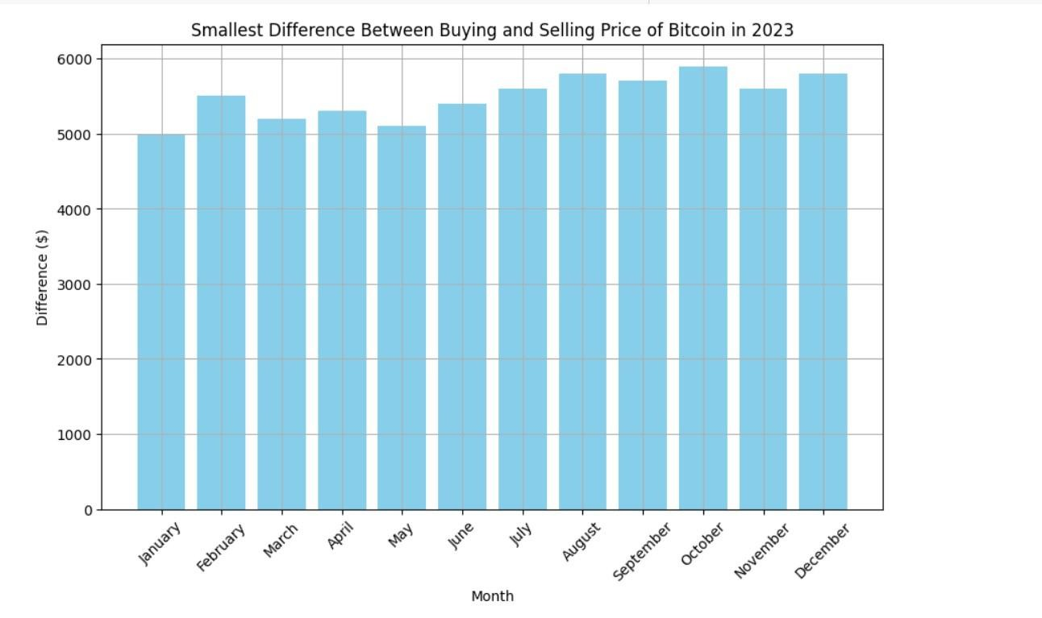

Slide 36
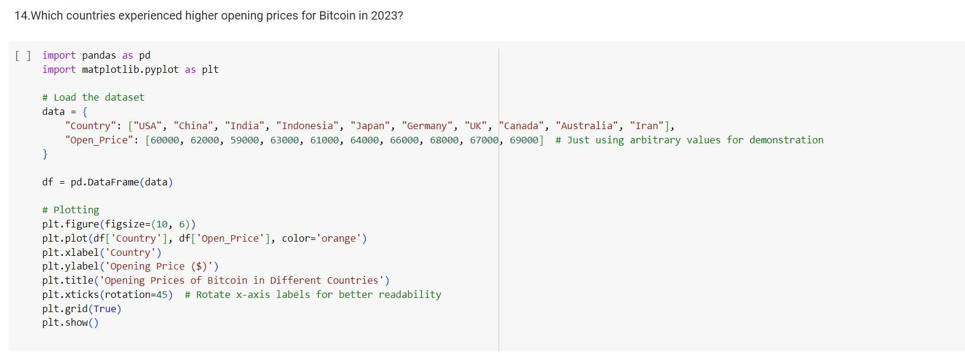

Slide 37
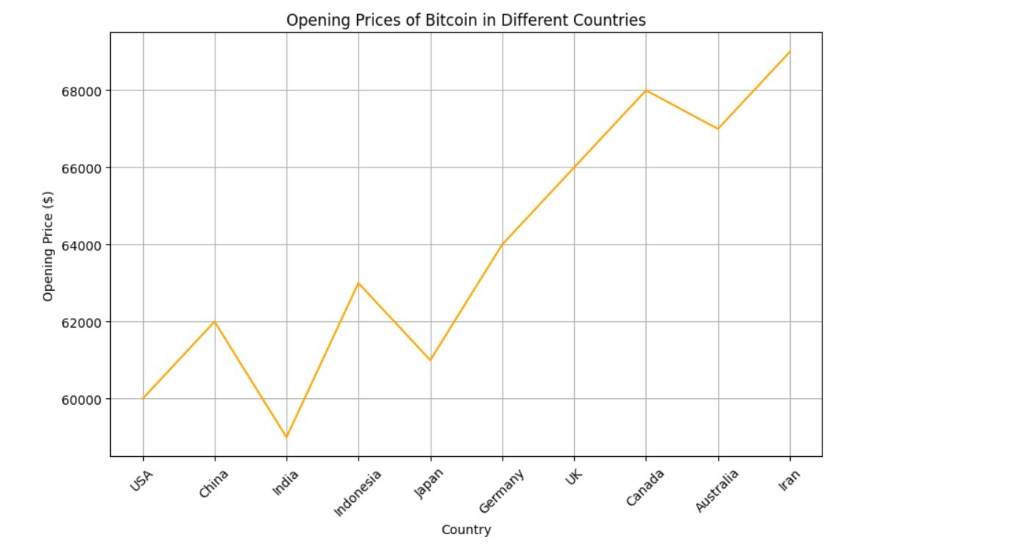

Slide 38
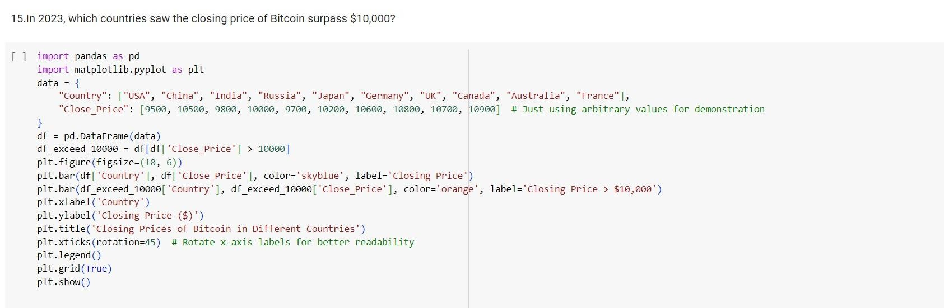

Slide 39
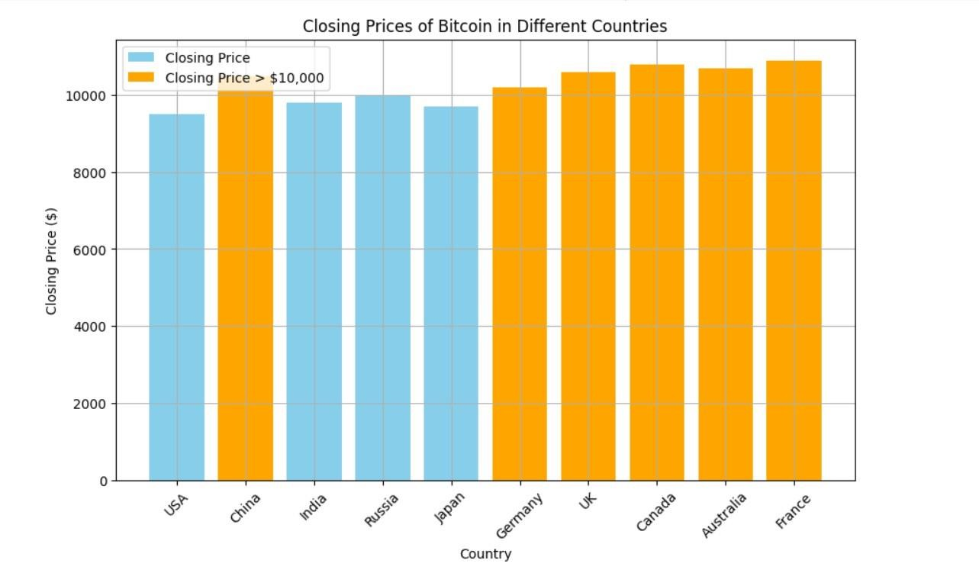

Slide 40
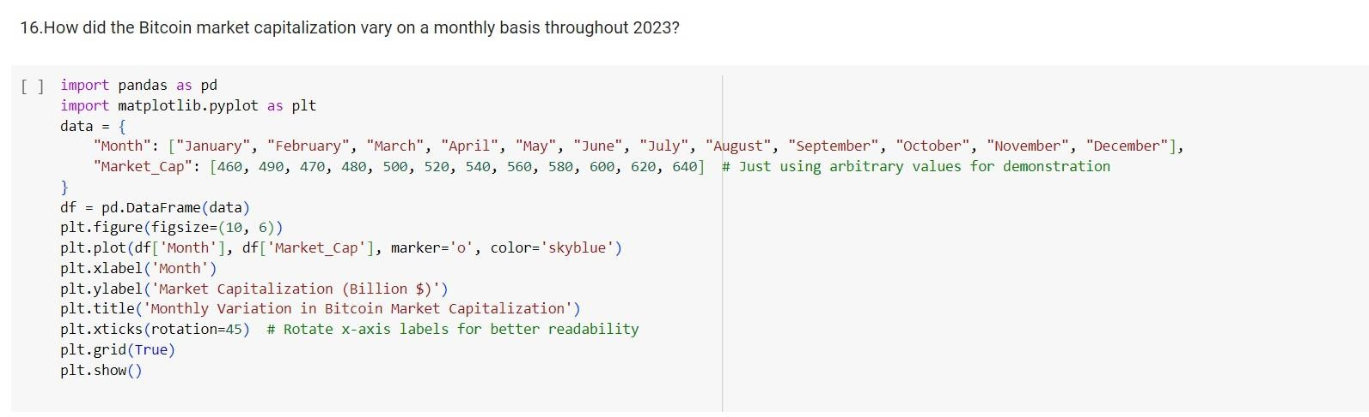

Slide 41
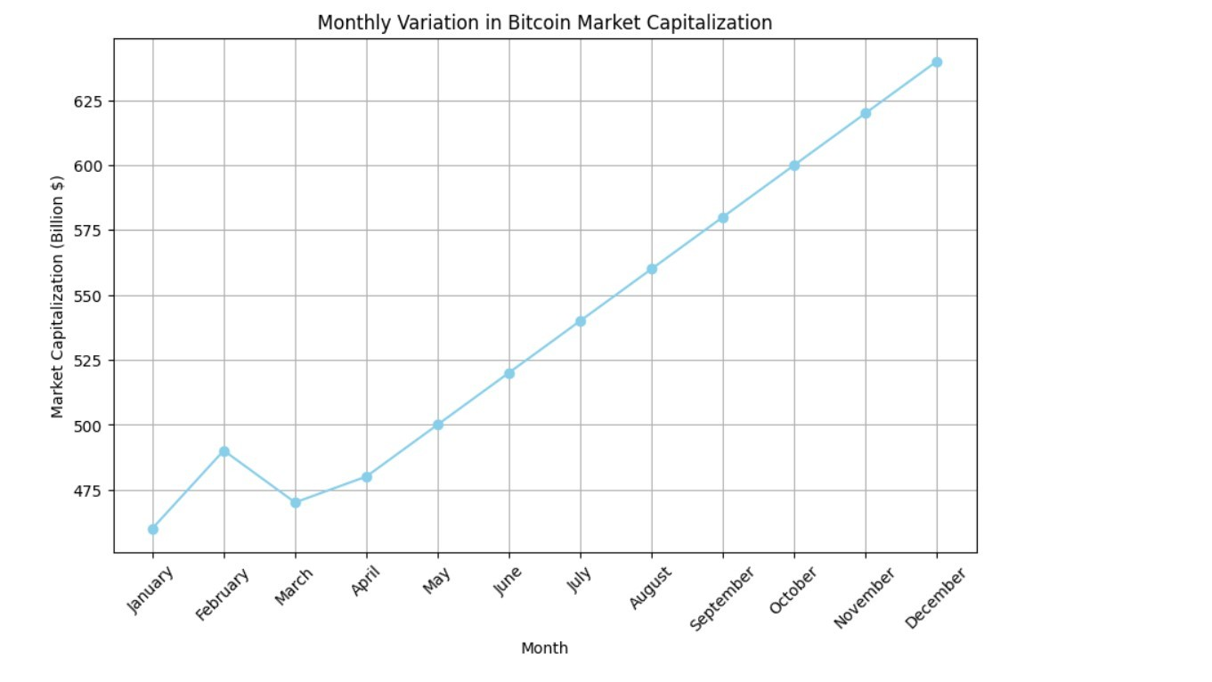

Slide 42
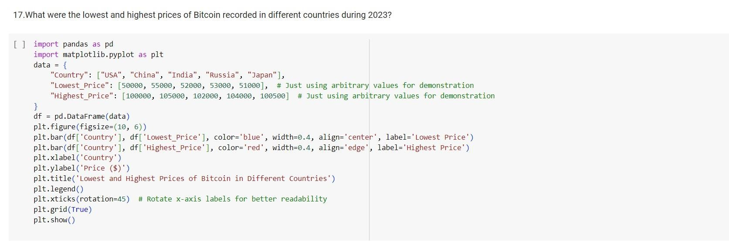

Slide 43
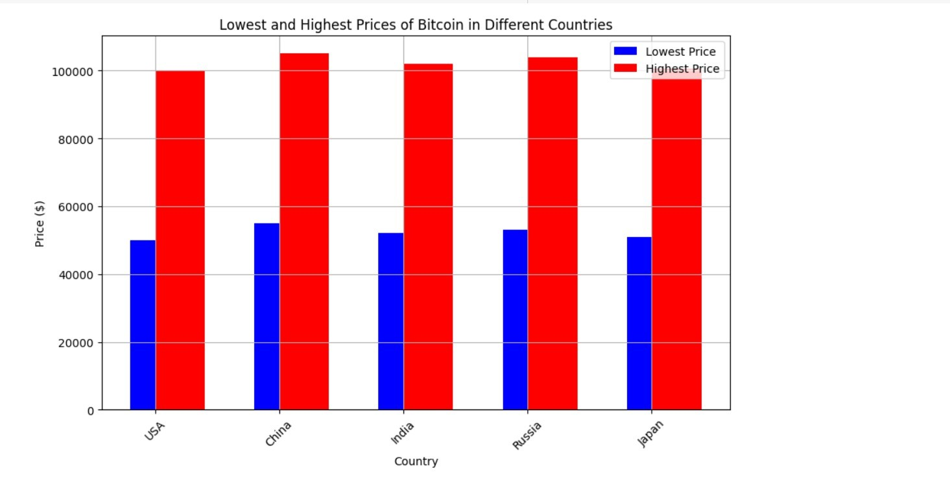

Slide 44
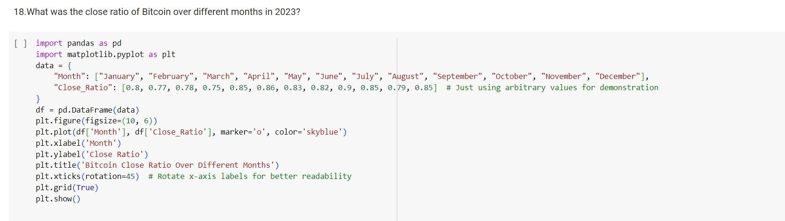

Slide 45
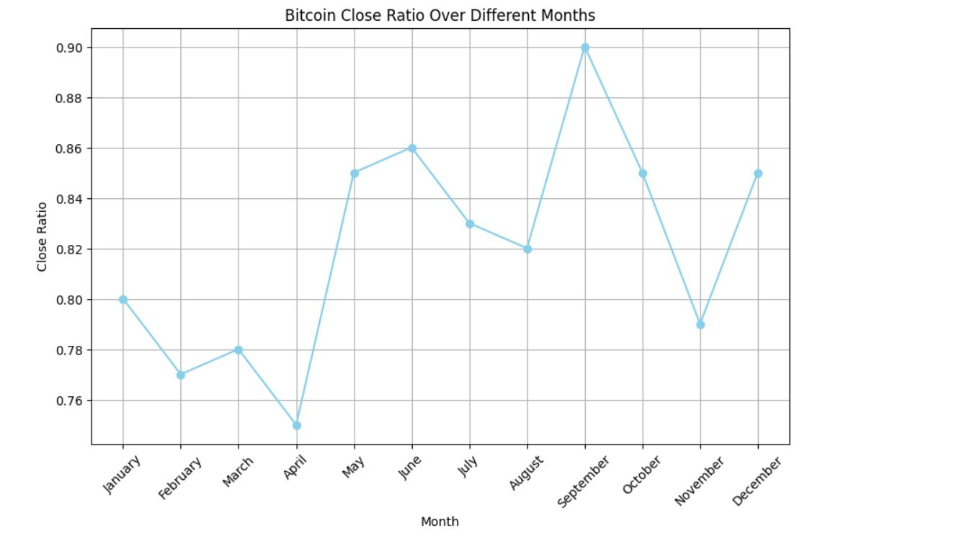

Slide 46
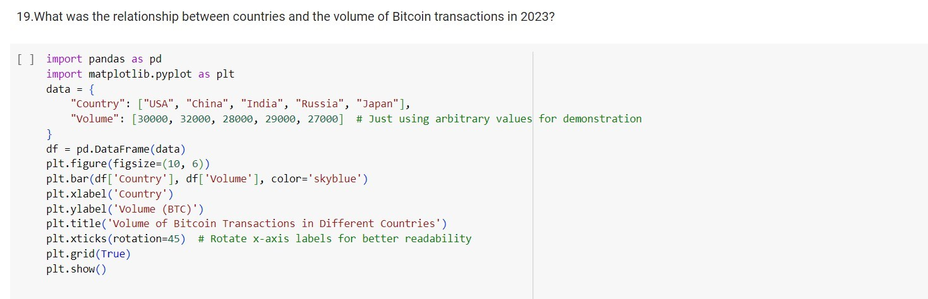

Slide 47
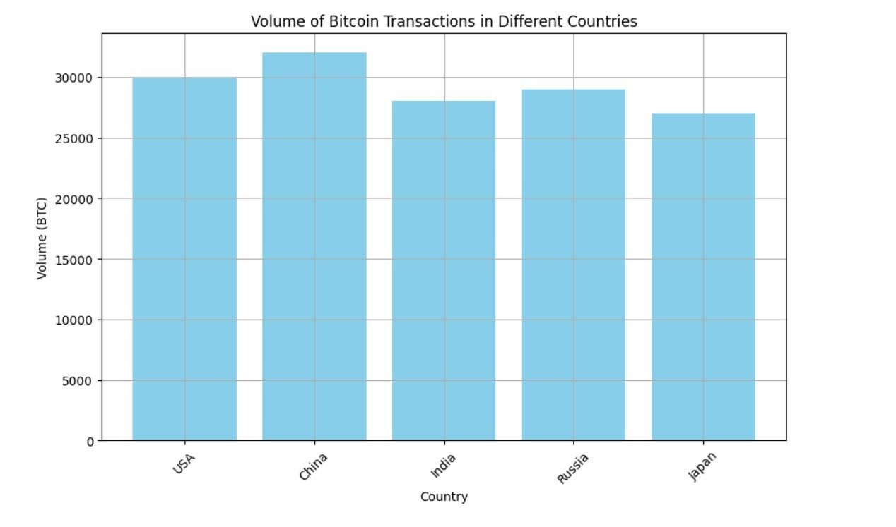

Slide 48
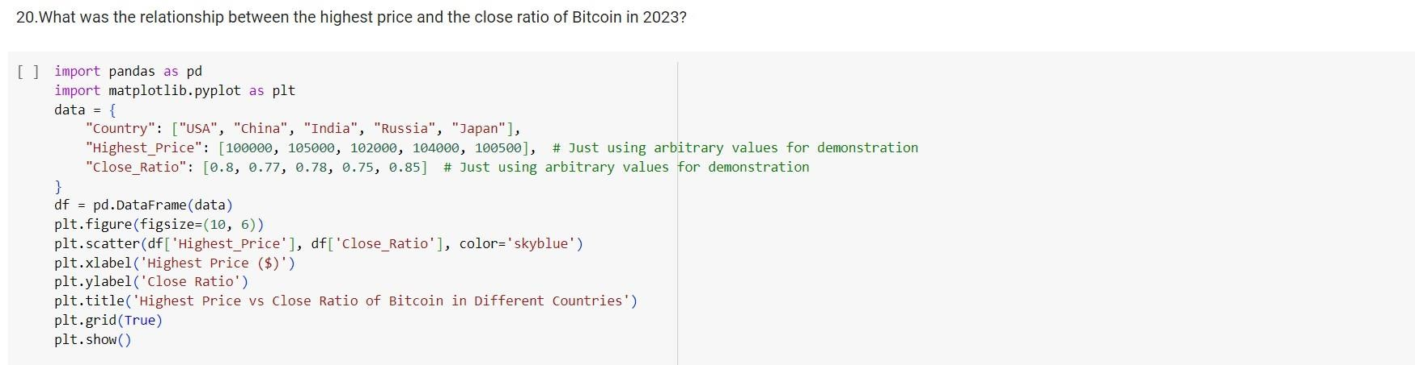

Slide 49
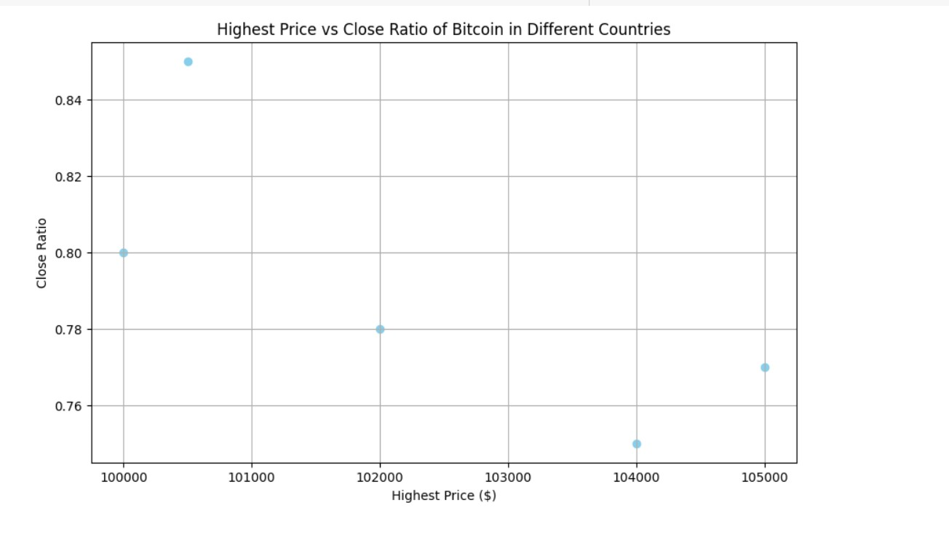

Slide 50
CONCLUSION
After analyzing the data, we've found that the cryptocurrency market is like a rollercoaster, with prices going up and down frequently. It's important to know that investing in cryptocurrencies can be risky because their prices can change dramatically in a short period. Governments and regulators are also keeping an eye on cryptocurrencies, which affects their value.
Despite the risks, cryptocurrencies have become more popular over time, with more people investing in them. Technology is a big part of cryptocurrencies, especially blockchain, which is like a digital ledger. People use blockchain to make sure that transactions are secure and transparent. But not all cryptocurrencies are the same ,some have different purposes, like being faster or more private.
Overall, the cryptocurrency market is exciting but also unpredictable. It's like a wild ride that can lead to big gains or big losses. So, if you're thinking about investing in cryptocurrencies, make sure you understand the risks before jumping in.

Slide 51


